Slide 1

Job Recommendation System
Using Content-Based Filtering
By:
Jagadeesh Nadimpalli
Saketh Reddy Dodda
Navya Chalamalasetty

Slide 2
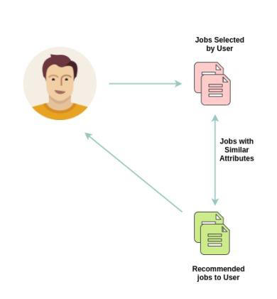
Introduction
Recommendation system It is a technology that analyzes a user's professional profile and preferences to suggest relevant job opportunities.
Content based filtering
Natural Language Processing It is used to analyze job descriptions and user profiles, extracting key skills and qualifications to match candidates with the most suitable job opportunities.

Slide 3
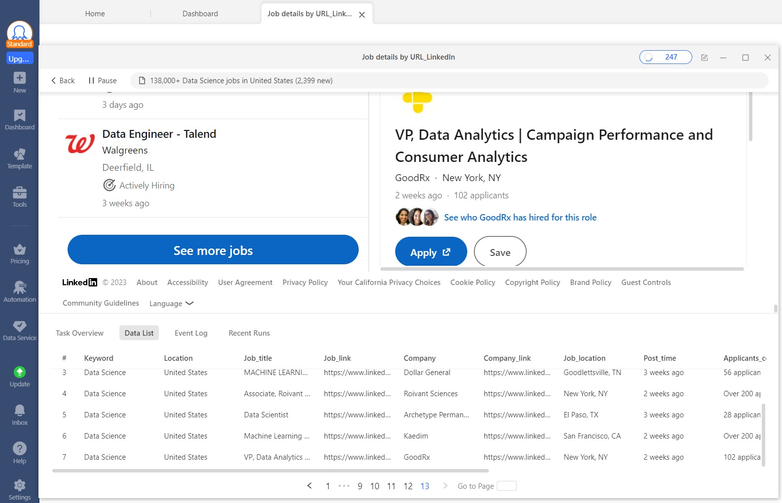
Data Description
Job Posting Data: Used OctoParse, a web scraping tool, to extract job posting information from LinkedIn.
Data Volume: Gathered a comprehensive dataset of 3684 records
Data Format: Excel

Slide 4
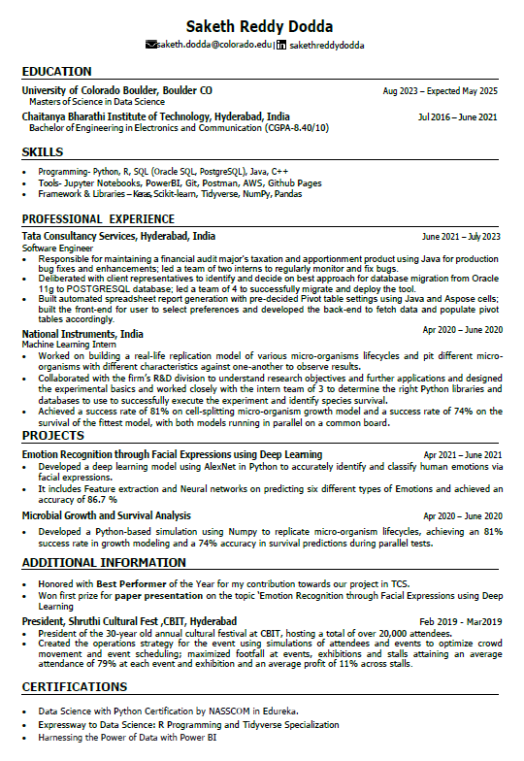
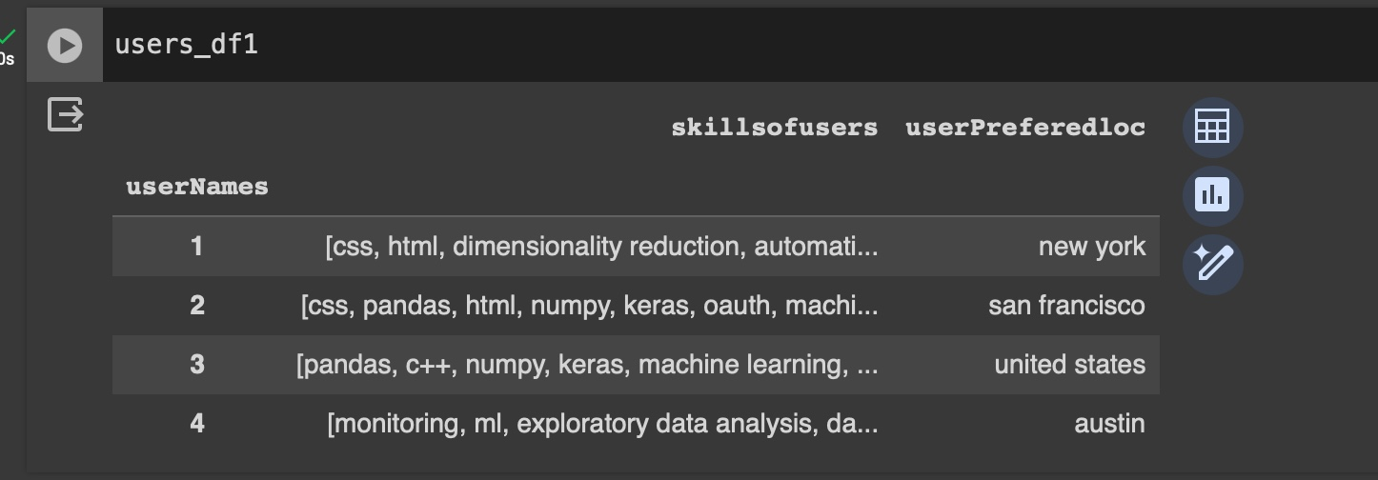
Data Description Contd.
User Data: Extracted the skills from Resume using Natural Language Processing(NLP) Techniques.
Skills Of Users
automation,nlp,r,html,keras,generative adversarial networks,excel,numpy,javascript,java,natural language processing,deep learning,css,azure,clustering,pytorch,classification,machine learning,regression,sql,python,pandas,artificial intelligence,dimensionality reduction
PDF Reader
Matcher
Fig. User Resume

Slide 5
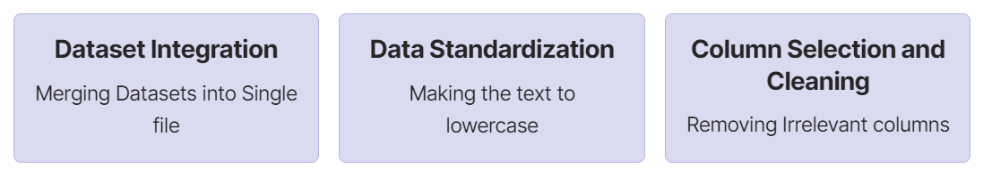
Data Preprocessing
The data preprocessing stage of our project involved meticulous organization and refinement of job data.

Slide 6
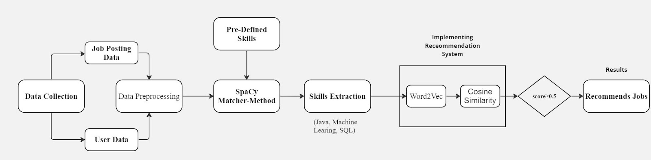
Methodology
SpaCy
Fig. Flow-Chart of our Recommendation System

Slide 7
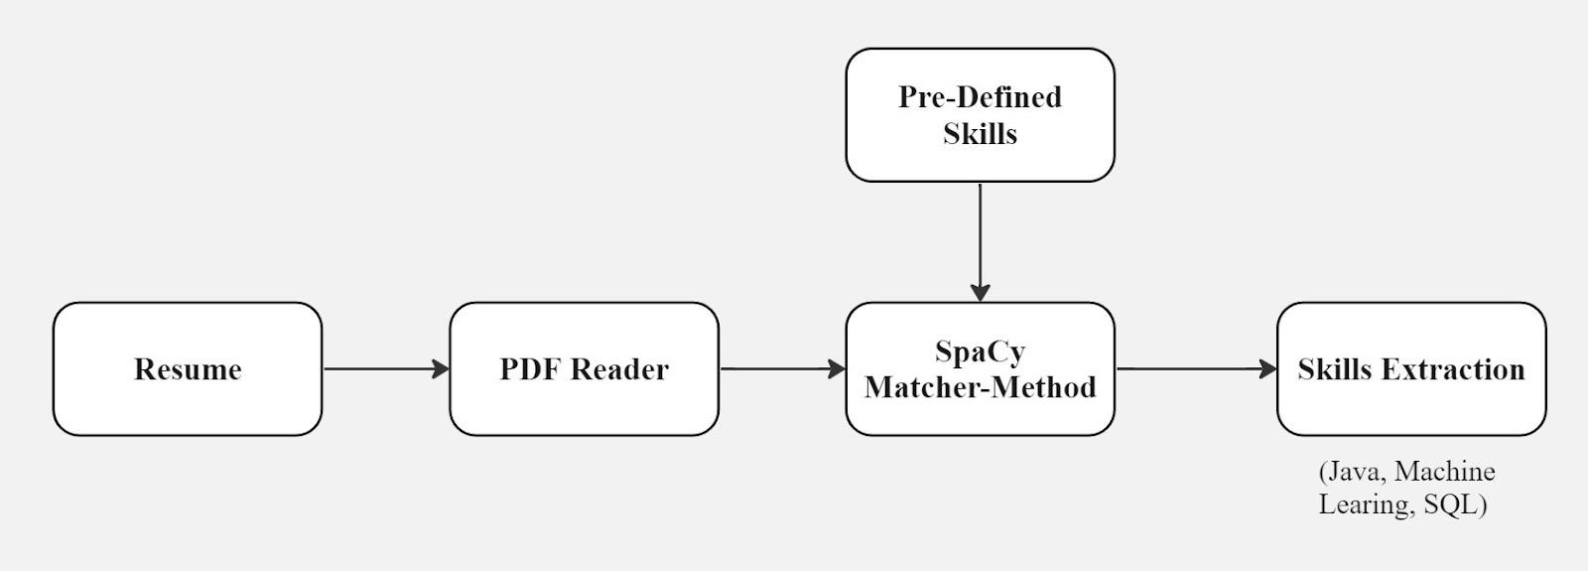
Methodology Contd.
SpaCy Implementation:
SpaCy is an open-source Natural Language Processing (NLP) library widely used for text processing and analysis.
Example: "SpaCy is a powerful NLP library." -> [SpaCy] [is] [a] [powerful] [NLP] [library]

Slide 8
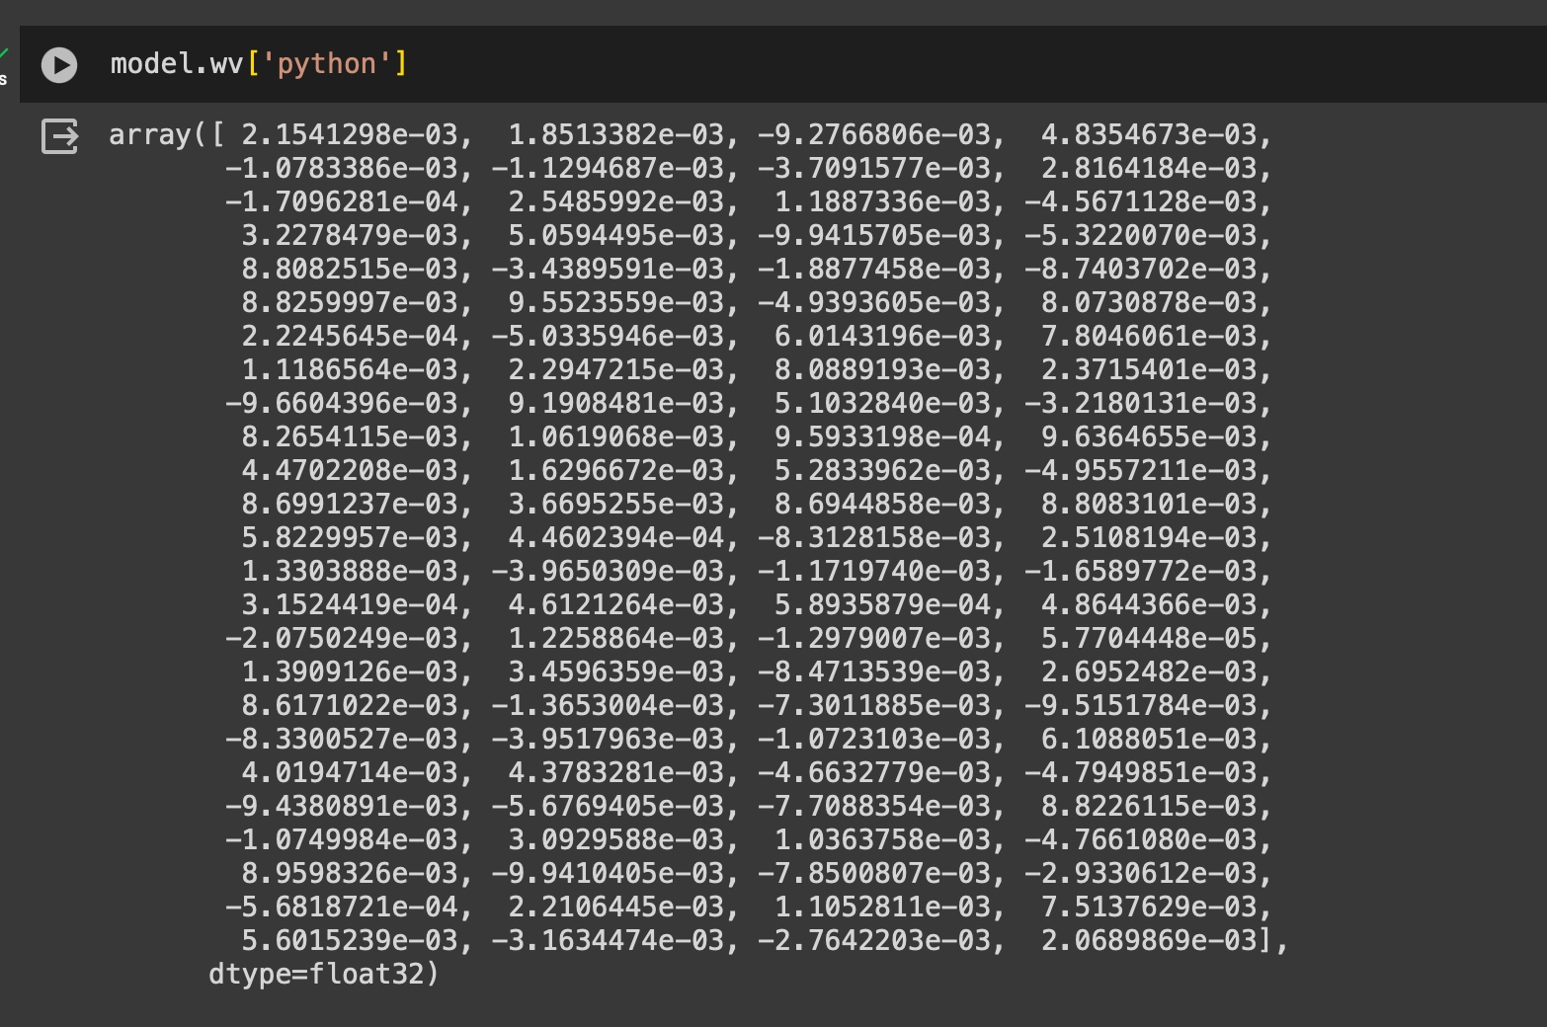
Methodology Contd.
Word2Vec
We developed a Word2Vec model with a dimensionality of 100, enabling each skill to be represented as a 100-dimensional vector.

Slide 9
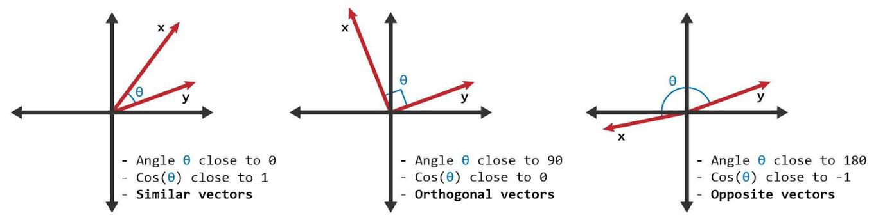
Methodology Contd.
Cosine Similarity:
Cosine Similarity(A, B) = (A · B) / (||A|| * ||B||)
Final_Similarity_Score = (0.8*Skill_Similarity) + (0.2*Location_Similarity)

Slide 10
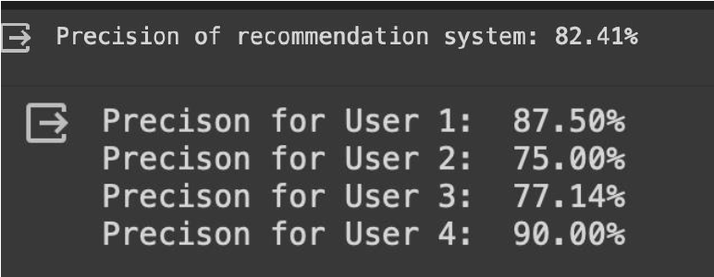
Evaluation
Why Precision?

Slide 11
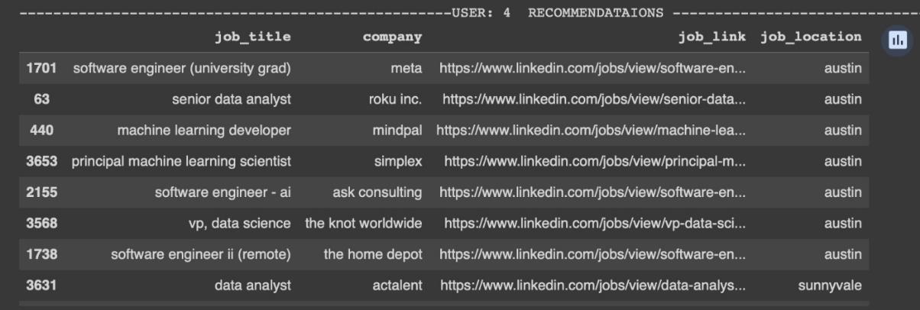
Results
Job Recommendations for a User Based on Skills and Preferences

Slide 12
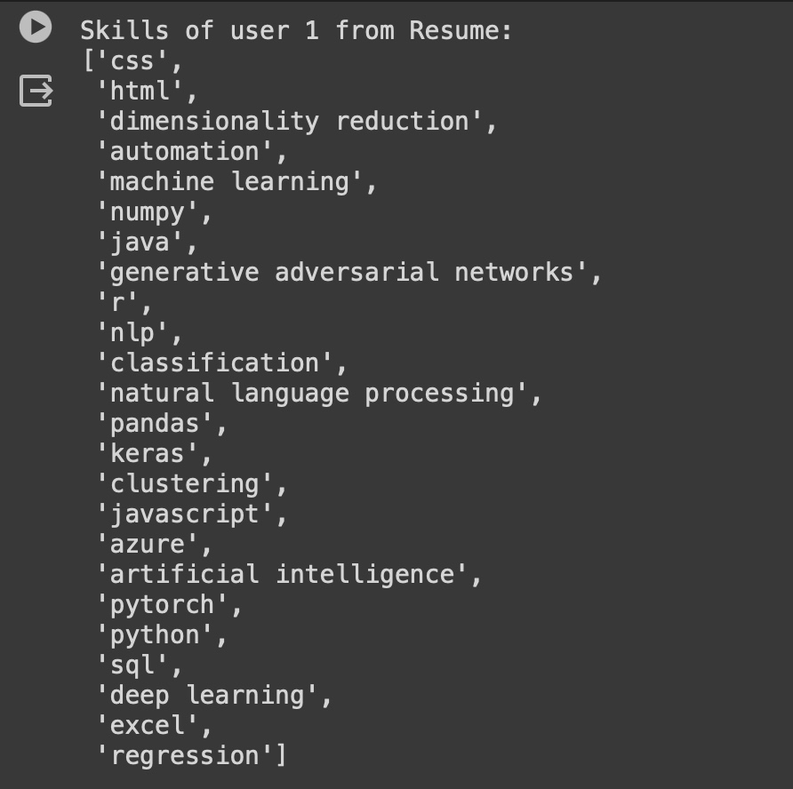
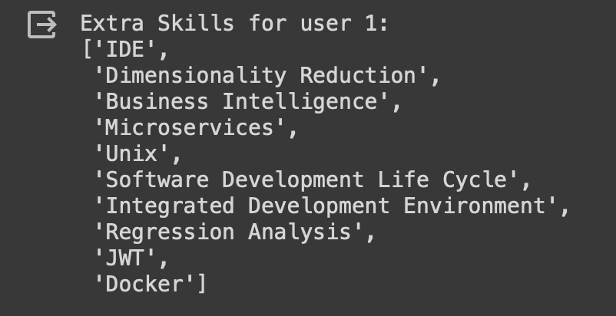
Results Contd
Extra Jobs Recommended if a user is willing to learn these
New Skills

Slide 13

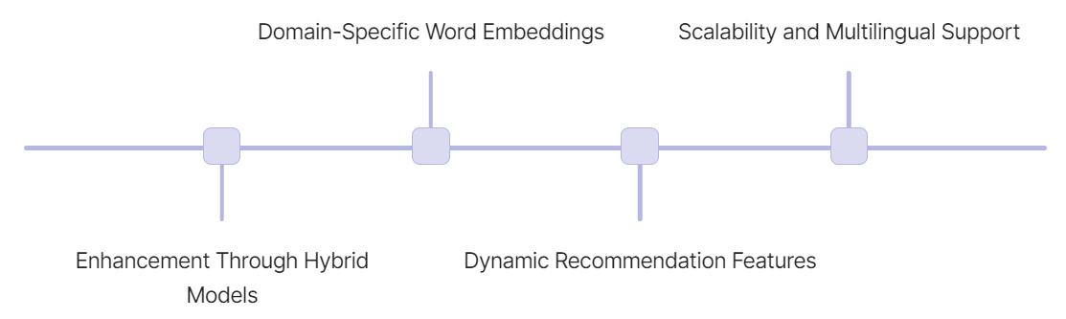

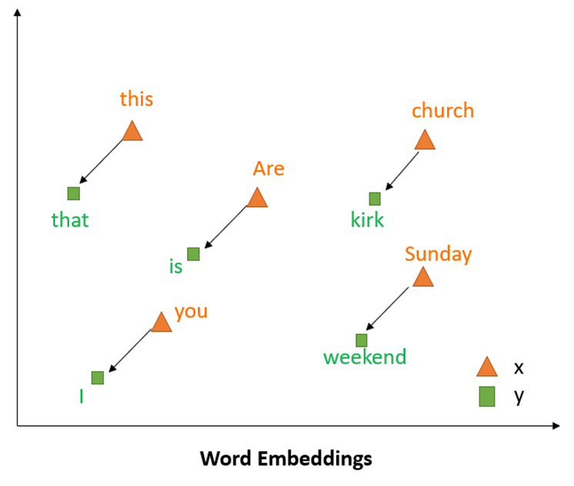
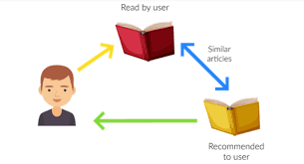

Future Work

Slide 14
Conclusion
Advanced System: Achieved an advanced job recommendation system with high precision of 82.41% using content-based filtering.
Data Extraction: Employed SpaCy's 'matcher' and 'PdfReader' for effective resume skill extraction.
Targeted Recommendations: Used Word2Vec and cosine similarity for tailored job recommendations by skill and location.
Future Readiness: Demonstrated system's potential for adaptability and future enhancement in personalized job matching.

Slide 15
References
[1] Bogdan Walek, Vladimir Fojtik (2020). A hybrid recommender system for recommending relevant movies using an expert system. https://www.sciencedirect.com/science/article/abs/pii/S0957417420302761
[2] Tanya V. Yadalam; Vaishnavi M. Gowda; Vanditha Shiva Kumar; Disha Girish; Namratha M (2020). Career Recommendation Systems using Content based Filtering. https://ieeexplore.ieee.org/document/9137992
[3] Yingya Zhang, Cheng Yang, Zhixiang Niu (2015) A Research of Job Recommendation System Based on Collaborative Filtering. https://researchgate.net/publication/281653213_A_Research_of_Job_Recommendation_System_Based_on_Collaborative_Filtering
[4] M Viswa Murali, T G Vishnu, Nancy Victor [2019] - A Collaborative Filtering based Recommender System for Suggesting New Trends in Any Domain of Research. - https://ieeexplore.ieee.org/document/8728409
[5] Daniel J. Wang (2022), Building a Job Recommender for Non-Technical Business Roles via NLP and Machine Learning https://towardsdatascience.com/building-a-job-recommender-for-non-technical-business-roles-via-nlp-and-machine-learning-626c4039931e

Slide 16


